Slide 1
High Performance Scientific Computing
SOMNATH ROY
MECHANICAL ENGINEERING DEPARTMENT, IIT KHARAGPUR
Module : OpenMP programming
Lecture : Essentials of OpenMP Programming

Slide 2
CONCEPTS COVERED
OpenMP environment routines
Directives and constructs
Worksharing
Reduction clause
Scheduling
Nested parallelism

Slide 3
Execution environment routines
Routine | function
omp_set_num_threads | Specifies the number of threads for parallel region
omp_get_num_threads | Returns the total number of threads being executed in parallel region
omp_get_thread_num | Returns the id of the present thread
omp_get_num_procs | Returns the total number of processors available for the program
omp_in_parallel | Checks whether a particular region is being executed as parallel or not
omp_set_dynamic (enable/disable) | Enables or disables dynamic adjustment of thread numbers to get maximum benefit of an SMP architecture
omp_get_dynamic | Returns the logical variable true if dynamic thread arrangement is active
omp_set_nested (enable/disable) | Enables or disables nested parallelism

Slide 4
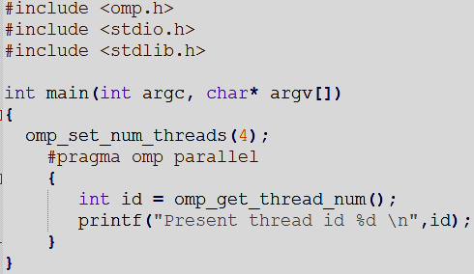
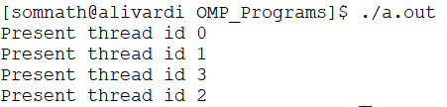
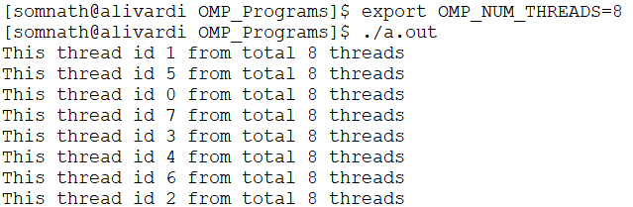
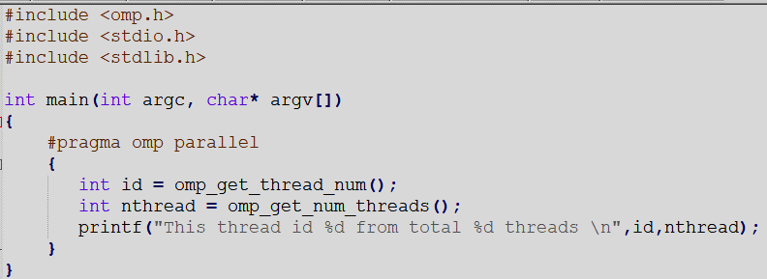
Execution environment routines- examples
Output
Output

Slide 5
Important OMP routines- directives
Important terminology
OpenMP Directive- In C/C++, a #pragma and in Fortran, a comment (!), that specifies OpenMP program behavior.
OpenMP directive syntax in C: #pragma omp directive-name [clause[[,]clause]…] new-line
in Fortran:!$omp directive-name [clause[[,]clause]…]
The different types of directives are:
(i) Declarative directive: The directive that is placed only on declarative purpose. threadprivate is the only
declarative directive.
(ii) Executable directive: A directive that is not declarative, but placed in an executable context.
Example: #pragma omp parallel num_threads (10)
{
/* do work here */
}
(iii) Stand-alone directive: An OpenMP executable directive that has no associated user code
Example: #pragma omp barrier
(iv) Loop directive: An OpenMP executable directive whose associated user code is a loop nest in form of a
structured block

Slide 6
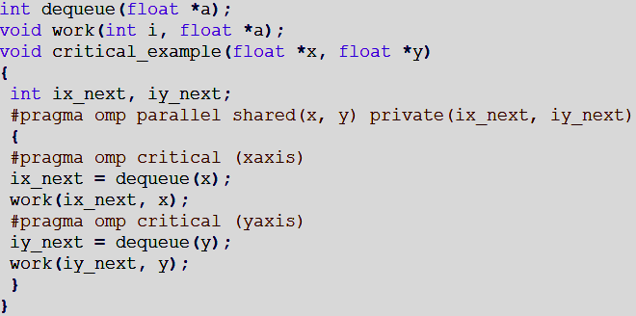
Important OMP routines- constructs
Important terminologies
Construct: An OpenMP executable directive (and for Fortran, the paired end directive, if any) and the associated statement, loop or structured block, if any, not including the code in any called routines. That is, in the lexical extent of an executable directive.
Example:
Parallel construct
Critical constructs
Region: A region may also be thought of as the dynamic or runtime extent of a construct or of an OpenMP library routine. Region includes any codes on called routines as well as implicit codes from OpenMP.

Slide 7
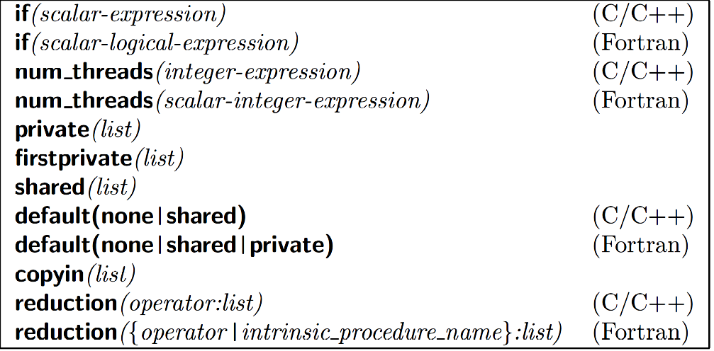
Parallel construct
C:
#pragma omp parallel [clause[[,]clause]….]
structured block
Fortran:
!$omp parallel [clause[[,]clause]….]
structured block
!$omp end parallel
Clauses supported by parallel construct

Slide 8
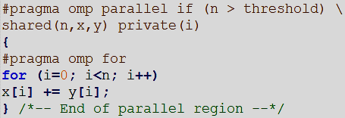
Parallel construct - example
if clause
shared and private variable declaration- also clauses
The ‘omp for’ directive parallelizes a for-loop (do-loop for Fortran) among the threads.
It does the load balancing too by distributing number of iterations among the threads
This directive can be written within a parallel construct only.
This directive is applicable only if the iterations are independent,
i.e., not for x[i]=x[i-1]+y[i]

Slide 9
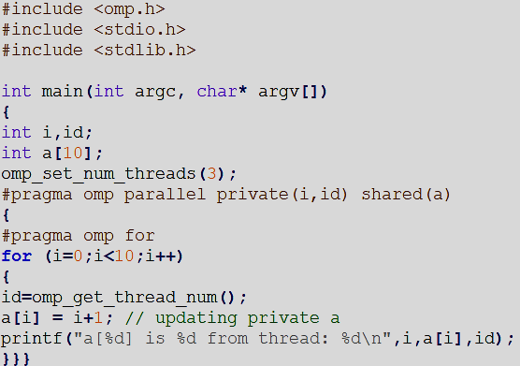
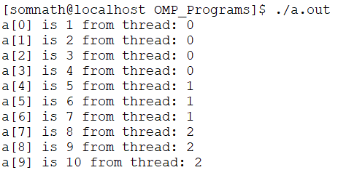
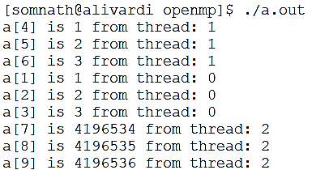
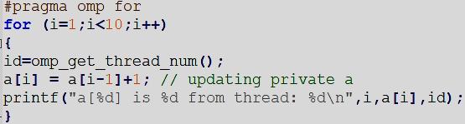
Parallel for - example
output
locally updated by each thread in its own part of do-loop
garbage
output
If the iterations are dependent, then it fails:

Slide 10
OpenMP worksharing directives
Functionality | C/C++ Syntax | Fortran Syntax
Distribute iterations among the threads | #pragma omp for | !$omp do
Distribute independent work unit | #pragma omp sections | !$omp sections
Only one thread executed the code block | #pragma omp single | !$omp single
* #pragma omp master – only master thread (thread id 0 executes the code block)
* #pragma omp critical- the threads execute the block one by one

Slide 11
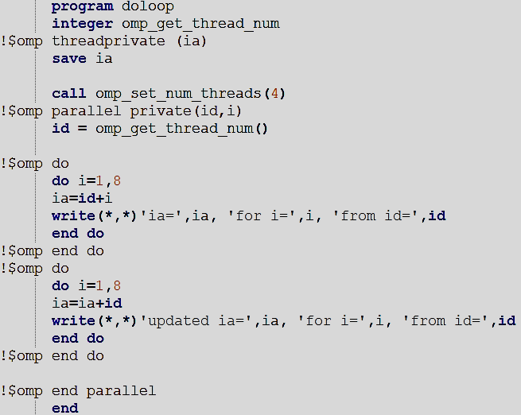
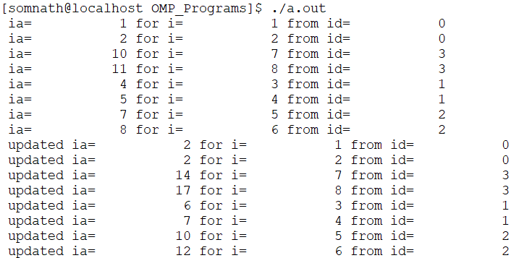
Loop constructs- Fortran
output
Update over the value kept in the thread as ia is threadprivate
implicit barrier
Iterations are mapped to the threads in the identical manner for all do-loops, if the number of iterations are same.
This is same in C also

Slide 12
Loop constructs - more
Clauses supported by loop construct
private (list)
firstprivate(list)
lastprivate(list)
Reduction(operator:list) (C/C++)
reduction({operator|intrinsic_procedure_name}:list) (Fortran)
ordered
schedule(kind, chunk size)
nowait

Slide 13
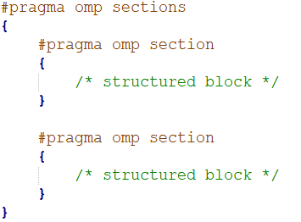
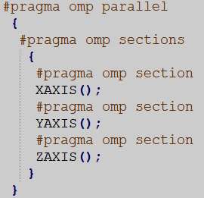
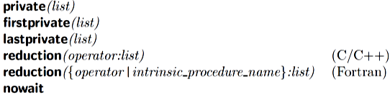
Section construct
Section construct divides the job into multiple sections and asks different processors (threads) to work on each different section.
By this, different subroutines or functions can be called in parallel
Clauses supported by section

Slide 14
Combined worksharing constructs
Worksharing constructs can be combined too
Full version | Combined construct
#pragma omp parallel { #pragma omp for for-loop } | #pragma omp parallel for for-loop
#pragma omp parallel { #pragma omp sections { #pragma omp section structured block #pragma omp section structured block } } | #pragma omp parallel sections { #pragma omp section structured block #pragma omp section structured block }
Similar constructs are available in Fortran too

Slide 15
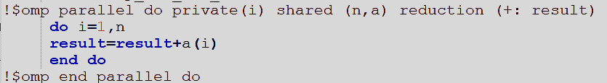
Reduction clause
Reduction is an optimized construct for doing parallelized repeating operation on a shared variable
OpenMP provides the reduction clause for specifying calculations involving mathematically associative and commutative operators so that they can be performed in parallel without code modification.
The programmer must identify the operations and the variables which will hold the result variables, the rest will be done by the compiler
The result will be a shared variable
It is advisable to use reduction clause instead of manually doing it in the code as this is an optimized call avoiding false sharing and race conditions.
The syntax is: reduction ({operator | intrinsic_procedure_name}: list)
C
Fortran

Slide 16
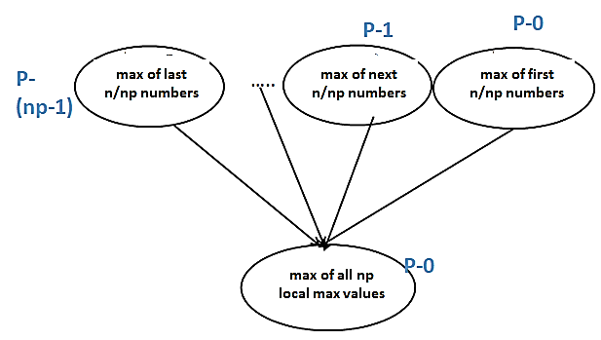

Reduction clause- scientific computing
Many of the scientific computing calculations require distributing the data in different chunks and asking threads to find the local min/max/sum etc. and then finding global value.
Reduction clause is of great use in these computations.
Finding Maximum of n-numbers

Slide 17
Reduction clause (cont.)
Reduction clause specifies and operator and a list of reduction variables (these must be shared variables)
OpenMP compiler creates a local copy for each reduction variable, intialized to operator’s identity (e.g., 0 for sum, 1 for multiplication, large number for min etc.)
After work-shared loop completes, contents of local variables are combined with the “entry” value of the shared variable
Final result is obtained by combining the local values and placed in the shared variable.
Compiler level optimization reduces contention and false sharing
Starting from OpenMP 4.0, user defined reduction functions are supported

Slide 18
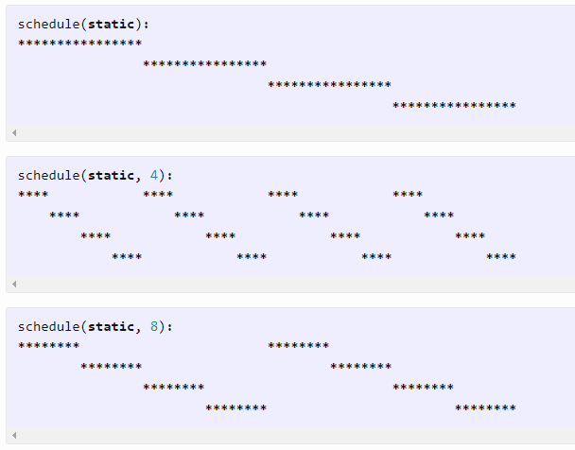
Schedule clause
Schedule clause determines how iterations will be mapped to the threads. This is typically of interest for large jobs where number of iterations are much more than number of threads and there might be uneven distribution!
#pragma omp parallel for schedule (static [,chunk-size])
-fixed size chunks assigned to num_threads
-typical default is chunk-size=iterations/num_threads
-set chunksize=1 for cyclic distribution
Example: 64 iterations using four threads
default- chunk size= 64/4=16 : 16 iterations in chunks go to threads
Chunk size=4: first 4 threads go to thread-0, 5-8 iterations go to thread-1….
Again iterations 17-20 go to thread-0, iterations 21-24 to thread-1 so on.
So, chunk size 1 will gives perfect cyclic distribution
Source: http://jakascorner.com/blog/2016/06/omp-for-scheduling.html

Slide 19
Schedule clause (cont.)
#pragma omp parallel for schedule (dynamic [,chunk-size])
-run-time scheduling (with associated overhead)
-each thread grabs “chunk-size” no. iterations off queue until all iterations have been scheduled
-good load balancing for uneven workloads
#pragma omp parallel for schedule (guided [,chunk-size])
-threads dynamically grab blocks of iterations
-chunk size starts relatively large, so that all threads are busy with less overhead
-subsequently, the chunk sizes reduce to get good workload balance. Specified chunk-size gives the minimum chunk size.
#pragma omp parallel for schedule (runtime)
-schedule and chunk size taken from environment variable or from runtime routines

Slide 20
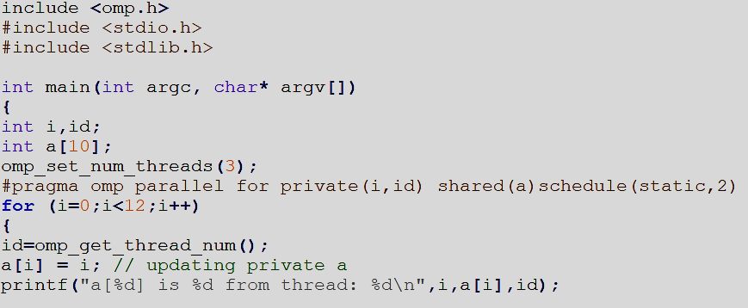
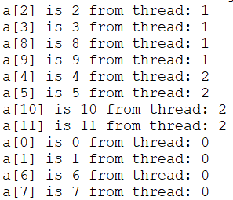
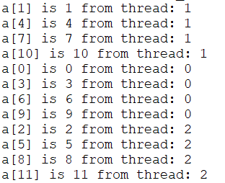
Schedule clause - examples
output
Full cyclic distribution

Slide 21
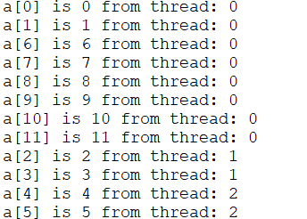
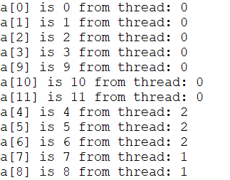
Schedule clause - examples
output
Dynamic distribution
Guided distribution

Slide 22
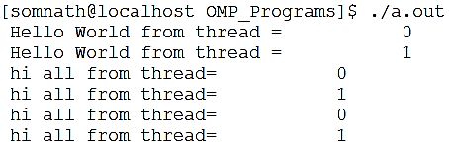
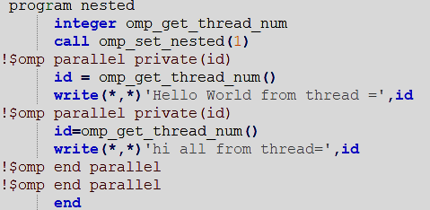
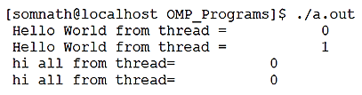
OpenMP– nested parallelism
Nested parallelism means parallel region within a parallel region. If any of the threads from a parallel region encounters a parallel region, it creates a team of threads and becomes the master thread (id 0) itself.
Output with 2 threads
Example- Fortran code
In case the omp_set_nested is commented, the threads from first region do not launch new threads, they alone perform the next job as independent single threads

Slide 23
REFERENCES
Using OpenMP by Chapman, Jopst, Van Der Pas
Parallel Programming in Fortran95 using OpenMP by Hermanns
A “Hands-on” Introduction to OpenMP by Tim Mattson
Parallel Programming for Science Engineering by Eijkhout https://pages.tacc.utexas.edu/~eijkhout/pcse/html/index.html

Slide 24
CONCLUSION
Directives, constructs and clauses for OpenMP calls are shown
Recursion and scheduling clause discussed
Nested parallelism introduced

